Slide 1
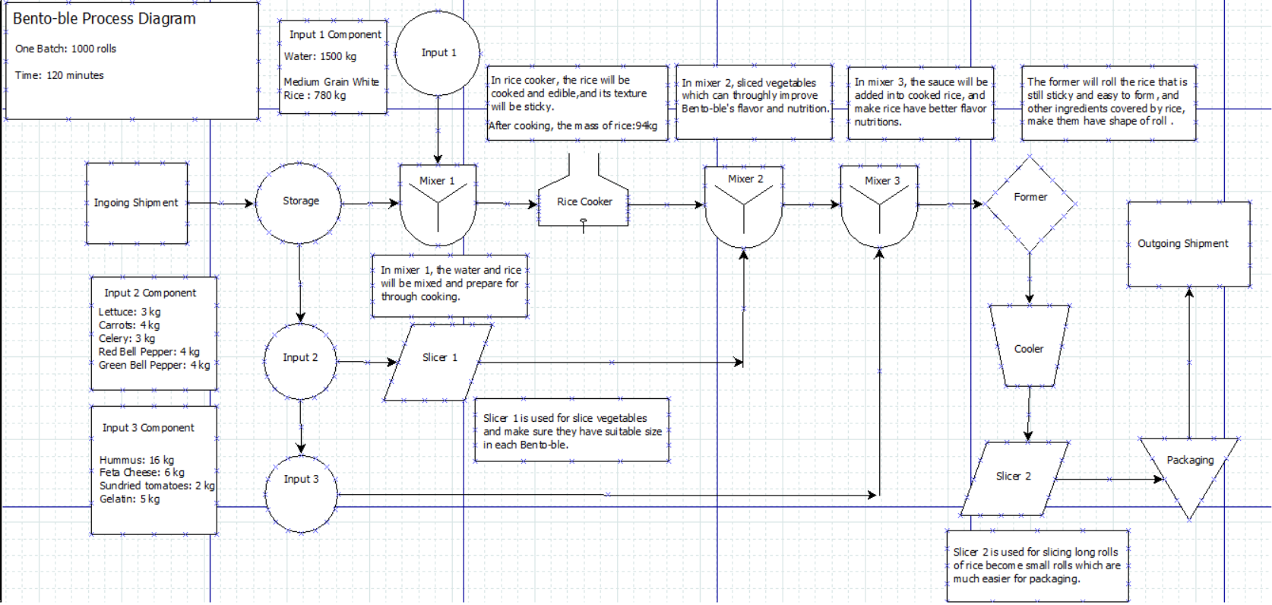
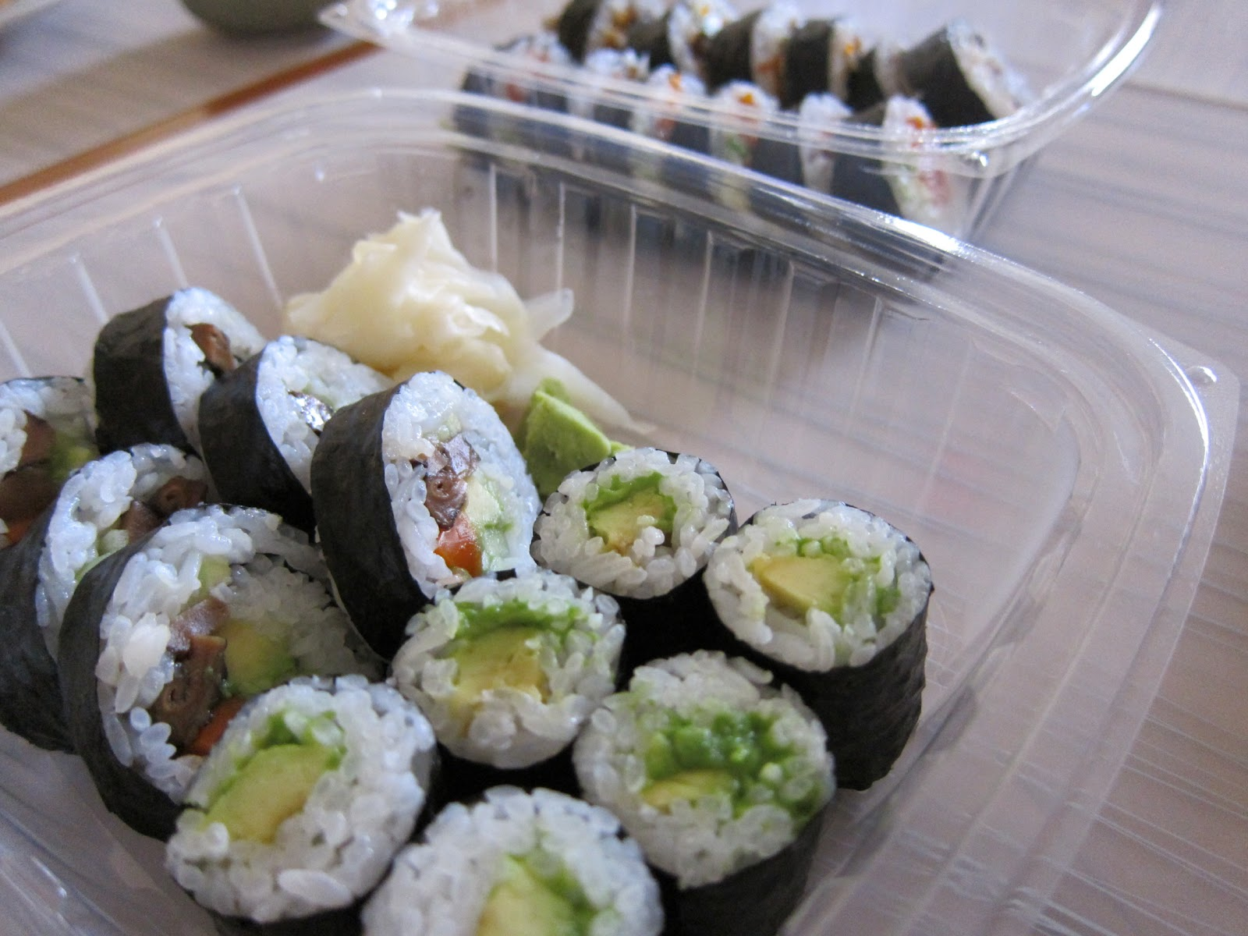
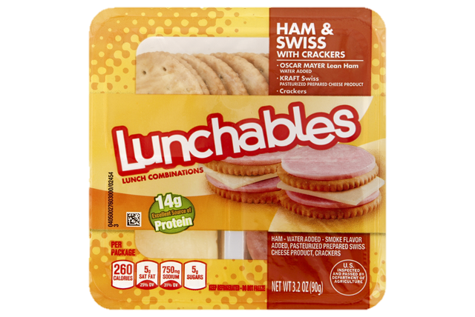
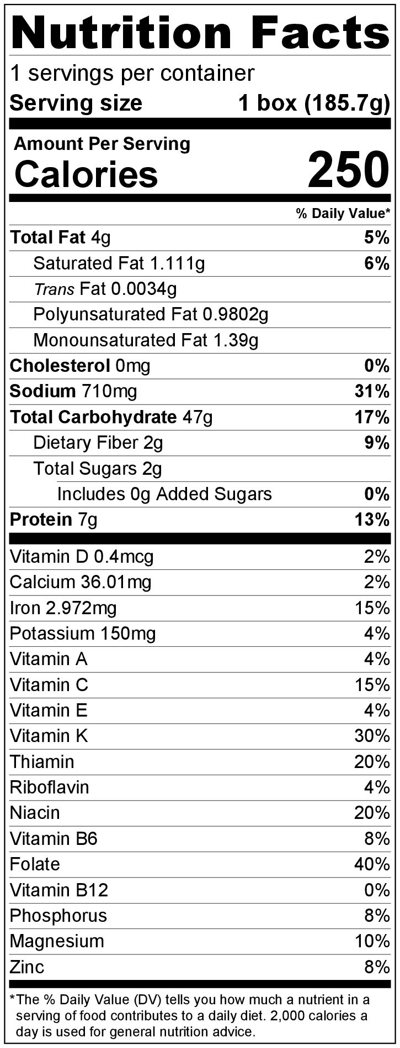
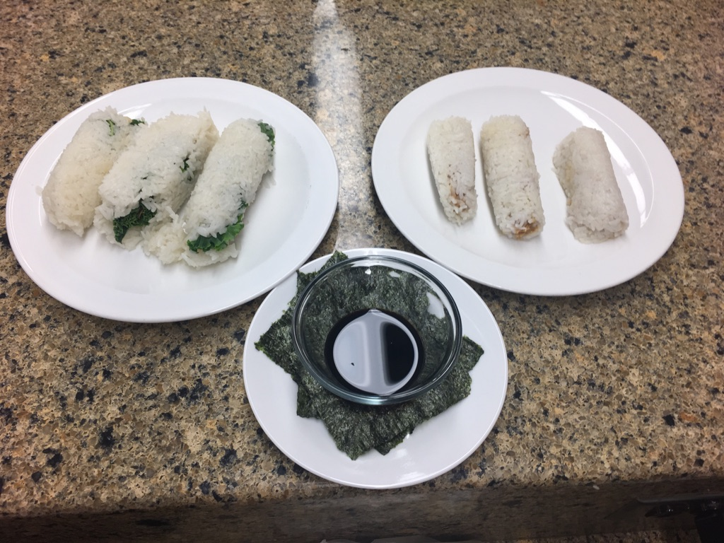
Bento-bles: Sushi Lunch on the Go!
ABE 20100, Team 6: Kathryn Atherton, Celine Chang, Tony Hoch, Sarah Reichstetter, Hongji Zhang
December 5, 2016
Sensory Analysis
Process Diagram
Target Consumer
18 – 22 years of age, any race, any gender
Designed for college students looking for a healthy on-the-go meal replacement
Competition
Take-out sushi Lunchables
260 – 340 Calories / Container
$2.55 / serving
Innovation
Target demographic most health conscious and culturally curious
Millennial generation most attracted to rice and hummus of all demographics
Nutrition Facts, Formula, and Mass Balance
Energy Balance
Processing Hurdles
The degree of stickiness of rice is relatively hard to control and might influence the texture and flavor of product.
Sticky rice causes odd flavor in product.
Slick rice makes for a mess of a roll.
Inconsistencies in cooking process of rice caused for many forms of rice to be created.
Maintaining a uniform balance of ingredients within core of roll is difficult with the amount of rice required to maintain the structural integrity of roll.
Ingredient | Mass
Medium grain white rice, cooked | 141 g
Hummus | 9 g
Carrots | 1 g
Red Bell Peppers | 4 g
Green Bell Peppers | 4 g
Feta Cheese | 1 g
Gelatin | 4 g
Kale | 5 g
Peanut Butter | 2 g
Peanuts | 2 g
Dark Chocolate Chips | 2 g
Chia Seeds | 0.2 g
Seaweed | 2.5 g
Soy Sauce | 8 g
Mass Balance | 185.7 g
Heating Sushi/Water Mixture
.65kw*.383hr = 896.22KJ
Cp = 4.18*.645 +1.711*0.025 + 1.928*0.008 + 1.547*0.322
Cp = 3.25
Delta H = m*cp*delta T
Delta H = 2199.54g*3.25J/G*C*(100C-20C)
Delta H = 571.88KJ
Thermal Efficiency = Work Out/Qin
Thermal Efficiency = 571.88KJ/896.22KJ
Thermal Efficiency = 63.8%
Previous Products
Previous ideas only included the main roll with a variety of cuisines, including Mediterranean, Indian, and Chinese cuisines
Mediterranean was decided upon due to the nutritional aspect of the ingredients
After testing with some sweeter ingredients, the Bento Box idea was created to combine both sweet and savory rolls
Selection criteria for final product included structural integrity, a new, innovative product, and a variety of options with different tastes and/or cuisines
Nutrition
Meets goal of containing < 0.1 g of trans fat
Does not meet micronutrient goals due to taste and structural needs
Meets whole foods goal: 85.7% of product is made of whole foods
Improvements
Shelf life of the product is below desirable for companies seeking max profits.
Shelf life could be improved by adding preservatives to the food.
Perfecting the ingredients and cooking process for the rice will improve the taste and customer satisfaction for the product.
Maintaining uniformity of ingredients throughout roll could help with some issues of taste that came up in consumer testing.

